Slide 1
Proposed Effects of Early Agriculture on Current Climate
Elise Reed WIMIN 2015 September 19th, 2014

Slide 2
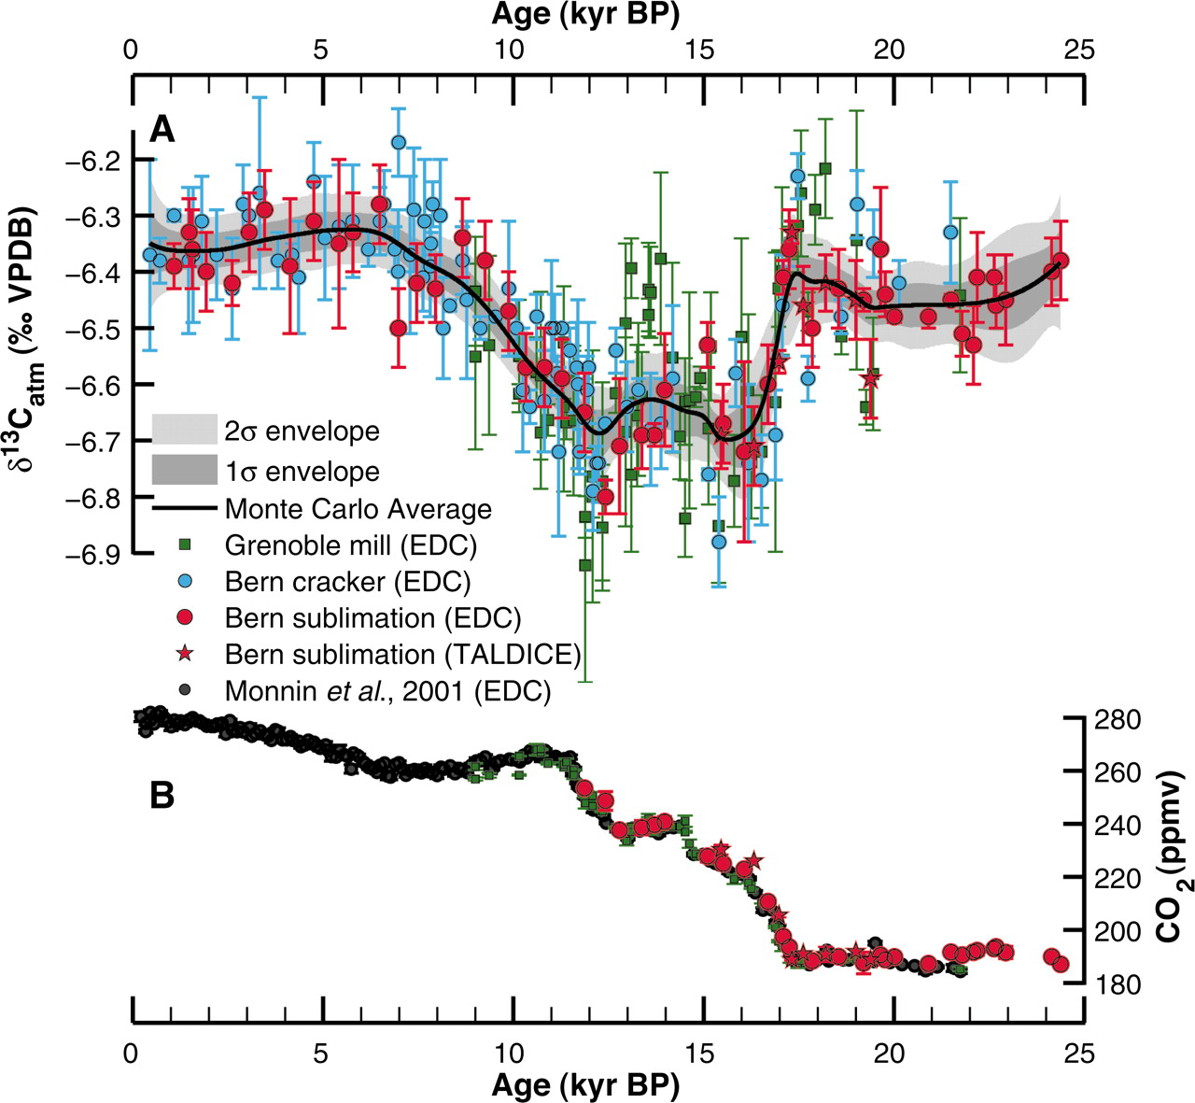
The Early Anthropogenic Hypothesis
Proposed by paleoclimatologist William Ruddiman in 2001
Contends that the Anthropocene began about 8,000 years ago, not in the 1800s as is widely agreed upon
Supported by the evidence of departure from regular Milankovitch cycle trends
Also supported by the timeline of development of human agriculture
Schmitt, J., R. Schneider, J. Elsig, D. Leuenberger, A. Lourantou, J. Chappellaz, P. Kohler, F. Joos, T. F. Stocker, M. Leuenberger, and H. Fischer. "Carbon Isotope Constraints on the Deglacial CO2 Rise from Ice Cores." Science (2012): 711-14. Print.

Slide 3
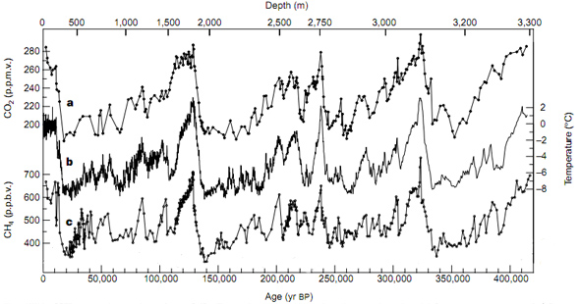
Milankovitch Cycles and the Overdue Glaciation Hypothesis
In past interglacial states, there was a never a late-deglacial CO₂ max
Holocene followed this trend up until 8,000 years ago, when we see an anomalous rise
Most models agree that new glaciers would be forming by now, if human effects were ignored
23,000 year cycle predicts max CO₂ ~10,000 years ago then decrease to present
41,000 year cycle predicts CO₂ decrease starting ~3,500 years ago
100,000 year cycle predicts CO₂ max ~13,500 years ago, with a following long-term decrease
Ruddiman claims that this anomaly is caused by human activities
http://www.aip.org/history/climate/cycles.html

Slide 4
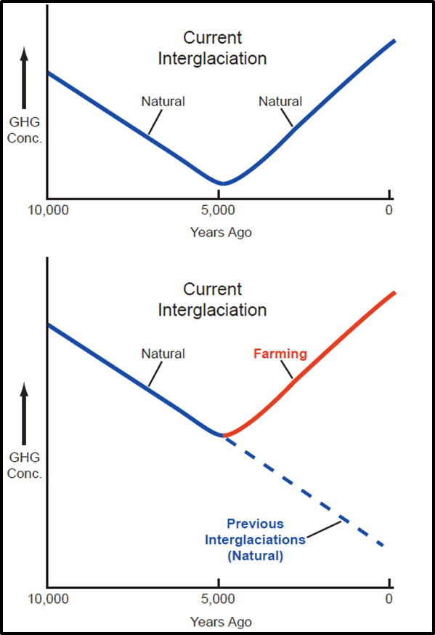
Causes of Deviation: Anthropogenically Induced Land Cover Change (ALCC)
Deforestation
Burning trees or hacking trees and leaving them to decay releases large amount of CO₂ from the terrestrial biosphere to the atmosphere
Primitive Agriculture
The agriculture practiced during the Neolithic Revolution was extremely inefficient
Practices included flooding large areas and overworking soil
It has also now been proposed that land use per person has not remained constant into the past; 8,000 years ago every person would use much more land than we each do today

Slide 5
Arguments against the Early Anthropocene and The Industrial Era View
Estimates for ALCC depend only on population while assuming land use per person has remained constant over the last 8,000 years
Based on this assumption, anthropogenic land use is predicted to be negligible before 1500 AD
This implies that ALCC could not have been a contributing factor in the rise of CO₂ starting 8,000 years ago
Natural Loss of Terrestrial Biomass
The best model of the land release/ocean uptake hypothesis would require a loss of ~200 GtC between 7,000-10,000 years ago, and no model supports such a large natural loss
Changes in Ocean Carbonate Ion Chemistry
8,000 years ago, forests started expanding into newly ice-free area, causing forests to extract CO₂ from ocean and atmosphere , in turn making ocean less acidic and inducing higher deposition of CaCO₃
This hypothesis is weak because we have never seen this activity in past interglaciations

Slide 6
The Alternative to the Industrial Era View
Field-based research does not support assuming constant per person land use
Instead it has shown that as population increases, per capita land use decreases
Over time, technology improves and with increasing population the amount of available land decreases
Kaplan, et. al has altered the Lund-Potsdam-Jena Dynamic Global Vegetation Model (LPJ DGVM) to handle the scenarios designed to quantify ALCC

Slide 7
Two Simulations
The HYDE 3.1 data base, published by Klein Goldewijk et. al in 2010, uses the assumption there is a near-linear relationship of population to land under anthropogenic use
The KK10 (Kaplan and Krumhardt 2010) scenario uses a new data base which has the main assumption that land use per capita, in general, has decreased over time

Slide 8
Total Land Under Anthropogenic Use

Slide 9
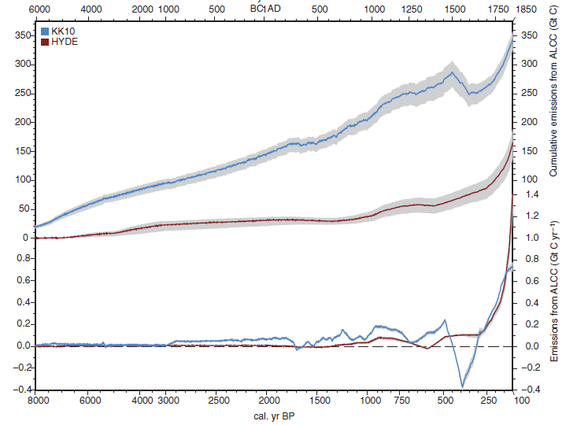
Cumulative Carbon Emissions and Annual Emissions

Slide 10
How does this support the Early Anthropogenic Hypothesis?
From Schmitt et. al’s ice core data we know there was a 15 ppm CO₂ increase in the atmosphere while trends in the Milankovitch cycles would predict a decrease in atmospheric CO₂
The KK10 scenario simulates emissions up to 102 PgC during this time period, which could have contributed to this rise in atmospheric carbon dioxide

Slide 11
Uncertainties
The two scenarios used produced vastly different estimates
Other estimates (Ruddiman and Ellis, 2009; Kaplan et. al, 2009) fall in the middle of these, leading to the idea that HYDE can be seen as a lower bound on anthropogenic effect while KK10 an upper bound
Cannot make direct comparison with ice core data – simulations do not include the effects of ocean chemistry, peatlands, and other elements

Slide 12
Incorporation into a model of the global carbon budget
Box model algorithm for understanding the global carbon budget
Alice Nadeau (University of Minnesota) has done extensive work designing this algorithm and inputting the carbon sink of North American Peatlands
Most recently, the anthropogenic carbon source has also been added into her model
In the future, we hope data on other sinks and sources will become available and will be added into this algorithm in order to achieve a complete understanding of the global carbon budget
Atmospheric Carbon (data from ice cores)
Global Sinks/Sources

Slide 13
Kaplan, Jed O. , Kristen M. Krumhardt, Erle C. Ellis, William F. Ruddiman, Carsten Lemmen, and Kees Klein Goldewijk. “Holocene carbon emissions as a result of anthropogenic land cover change.” The Holocene (2010). Web.
Nadeau, Alice, et. al. “Carbon isotope constraints from peat cores on deglacial changes in atmospheric CO₂.” Forthcoming.
Ruddiman, W.F. Earth’s Climate: Past and Future. New York: W.H. Freeman, 2001. Print.
Ruddiman, William F. “The Anthropogenic Greenhouse Era Began thousands of Years Ago”. Climate Change. 61.3(2003). 261-293. Springer Link. Web.
Schmitt, J., R. Schneider, J. Elsig, D. Leuenberger, A. Lourantou, J. Chappellaz, P. Kohler, F. Joos, T. F. Stocker, M. Leuenberger, and H. Fischer. "Carbon Isotope Constraints on the Deglacial CO2 Rise from Ice Cores." Science (2012): 711-14. Web.

